Slide 1
Introduction to Programming in Python
Ezekiel Adebayo Ogundepo (@gbganalyst)

Slide 2
Anaconda distribution

Slide 3
Anaconda distribution
Anaconda is a distribution of Python for scientific computing, that aims to simplify package management and deployment. The distribution includes data-science packages suitable for Windows, Linux, and macOS.

Slide 4
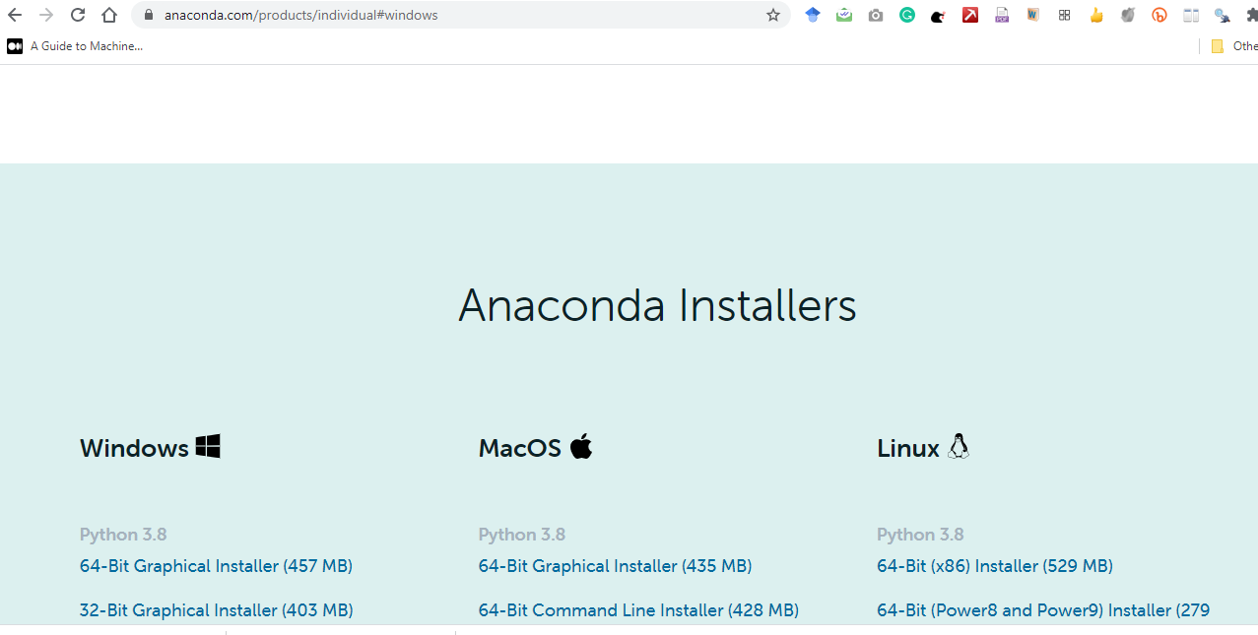
Anaconda Installation
To download Anaconda, visit http://bit.ly/cs2-anaconda
then click on Download
your Anaconda setup will start downloading. After download, you can now install it.

Slide 5
Anaconda Navigator
Anaconda Navigator is a desktop and graphical user interface (GUI) included in Anaconda distribution that allows you to launch applications without using command-line interface.

Slide 6
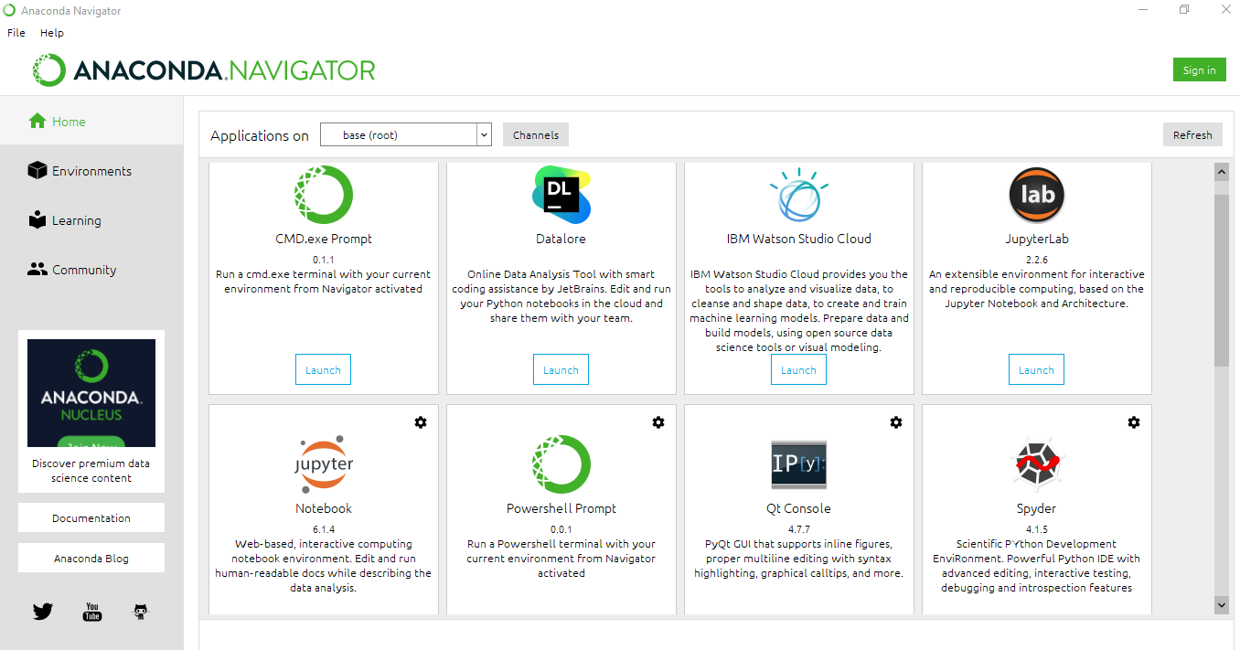
Anaconda Navigator

Slide 7

Jupyter Notebook and/or Jupyter Lab
Among many applications present in Anaconda are JupyterLab and Jupyter Notebook

Slide 8
Jupyter Notebook and/or Jupyter Lab
JupyterLab and/or Jupyter notebook is a web application that allows you to create and share documents that contain:
live code (e.g. Python code)
explanatory text (written in markdown syntax)
visualizations

Slide 9
How to launch JupyterLab and/or Jupyter Notebook
You can launch JupyterLab and/or Jupyter Notebook
Anaconda Navigator
Through terminal or Anaconda Prompt

Slide 10


